Slide 1

Assignment Workshop
Unit 1 - Sociology

Slide 2

Recap – Interactionsim
What examples can you think of where Symbolic Interactionism can be used to explain why an object or symbol that went from being desirable to undesirable or vice versa?
E.G. - Certain statues have been removed or defaced after people understood the historical racism associated with them

Slide 3
What You Need To Do
Table
Short Essay
Newspaper Article For The Conversation

Slide 4
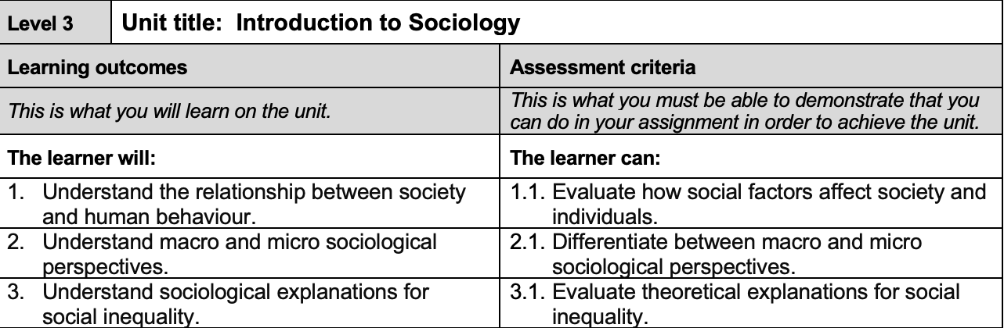
What MUST I Do To Pass Unit 1?

Slide 5
Task 1: Table – 300 Words (+/- 10%)
Prepare a table in which you identify the key aspects of a micro-sociological and a macro-sociological perspective (e.g. Functionalism, Marxism, Neo-Marxist, Feminism, Symbolic Interactionism).
Highlight the similarities and differences between the perspectives discussed.
Key Tips
BE BRIEF, BUT TO THE POINT
DON’T WAFFLE!
Be sure to cite the points being made in order for them to be legitimate and give you a stronger grade
Using Textbooks are good for the first assignment as are websites
Stronger students will be able to use a range of RELEVANT sources

Slide 6
Task 2: Short Essay – 800 Words (+/- 10%) – Evaluate the Following Statement:
Does who your parents are and what they do for a living matter?
In order to respond to the above essay title you should identify and evaluate the ways that
social factors (e.g. social class, gender, ethnicity, norms, values, behaviour, lifestyle) can affect individuals (e.g. in terms of education, health, attainment, employment) and
the implications this may have for wider society.
At least TWO (2) theories must be used to develop an evaluation.
Key Tips
Ensure the points highlighted above are addressed – do not leave me guessing
Make sure the two (2) theories used are relevant and it is clear why they are being used
Ensure the discussion provided is relevant
PEEL don’t PEE everywhere!

Slide 7


Slide 8
Task 3: Newspaper Article For The Conversation – 600 Words (+/- 10)
Briefly highlight an ongoing type of social inequality such as racial, gender, sexuality, class or health (such as disabilities and issues from COVID) and evaluate sociological explanations on how these inequalities exist.
Choose ONE (1) and compare it to another ONE (1) – all must come from the theories explored in this Unit.
Key Tips
You MUST use the template on the VLE to complete this task
Any that do not will have to resubmit
Go onto The Conversation’s website to see how they write their articles
Roughly speaking they present the problem, use theory, provide an answer
It is like an essay, but more informal – still stick to the standards set in the guidance on page 2 of the Unit brief
Speak about an issue you have an interest in

Slide 9
How To Get A Distinction
Guidance is found on the Unit brief, but in short it has to:
Be Relevant
Be easy to follow and understand
Have a consistent and logical argument
Do not throw me around from one point to another
Do not make me guess why a point is being made and another is not
Be supported throughout with accurate in-text citations and a reference list
Use a diverse range of sources
NOT USE WEBSITES WHO WRITE ASSIGNMENTS FOR YOU
PEEL not PEE
Be concise

Slide 10

Important Things To Consider
Write in paragraphs
Include a brief introduction to your essay
Concluding paragraph to act as a summary of the whole assessment
Proofread before submission
Does it make sense
Could you get to the point quicker?
Is there enough detail for the discussion?
Ask a critical friend – someone you’re comfortable with looking at your work
Cite and reference ALL the work used
Remember the reference list at the end!
Make sure it is 1700 words (+/- 10%)
Put your work through the plagiarism checker on the VLE/Moodle and PRINT OFF THE WHOLE ASSIGNMENT AND HAND IN AT CLASS!

Slide 11

How do you think an introduction and conclusion should be structured?

Slide 12
Writing An Introduction For Academic Work
It lets the reader know what to expect from reading your work
Provides the reader with the key argument/s stated
What topic/s and theory/theories will be explored
Briefly signposts the reader on how they will read the paper
Always do it last
You need to have written it all and finalised your arguments first
How else can you introduce something if you don’t know what you’re going to say?
First a definition will be made, followed by how theories x, y, z apply and finishes with an overall conclusion
This is a skill you will keep developing, even at University… Get a head start now!

Slide 13
Writing A Conclusion For Academic Work
It must wrap up everything in the main body
NEVER INTRODUCE SOMETHING NEW HERE
Highlight the key points and identify which is the best suited theory for the discussion
Highlight the major point/s which makes the theory the best here!
Do not just repeat the introduction’s key points
If there is something you did not mention, but is useful, put it in the main body AND conclusion
The conclusion and introduction work together
The reader should get a good understanding of your key points without reading all of your work
This is a skill you will keep developing, even at University… Get a head start now!

Slide 14

When’s the Deadline?
Monday Lesson - 23rd
12.00 or 3PM
Wednesday Lesson - 25th (Now Thursday 26th – 3pm)
Printed with OCN front pages, also submitted online via the VLE.

Slide 15

Any Questions?

